Slide 1
Longitudinal Analysis
William Lage

Slide 2
Contents
What is Longitudinal Analysis?
Real life application
Methodology

Slide 3
What is Longitudinal Analysis?
What it is
Longitudinal Analysis is a method for making predictions based on an averaging model rooted in regression when given data over time.
Longitudinal Analysis is useful when looking for differences between populations and within populations.
Longitudinal Analysis can be linear or non-linear and can contain fixed effects, random effects, or a combination of both.

Slide 4
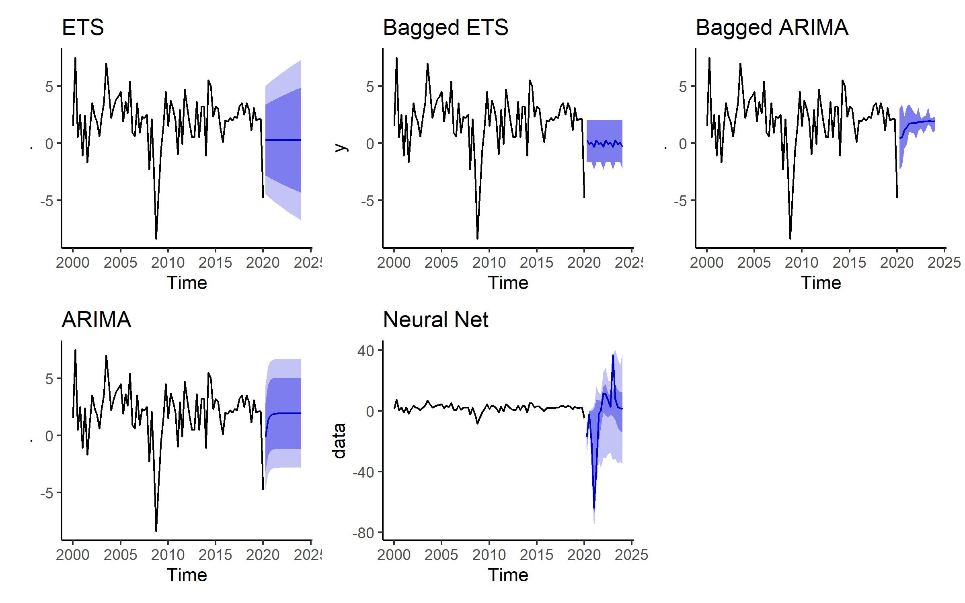
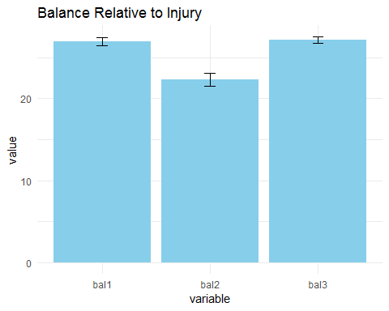
What is Longitudinal Analysis?
It is not a repeated measures analysis of variance (ANOVA)
It is also not time-series analysis
Longitudinal Analysis creates a model that tells the base difference between groups at the initial measure and change over time for each group. This is not the same as ANOVA which tells the difference at each time point like a snapshot.
Longitudinal Analysis is not a method for predicting outcomes based on observations of a single subject (ex: GDP). For that, use time-series or panel regression.

Slide 5
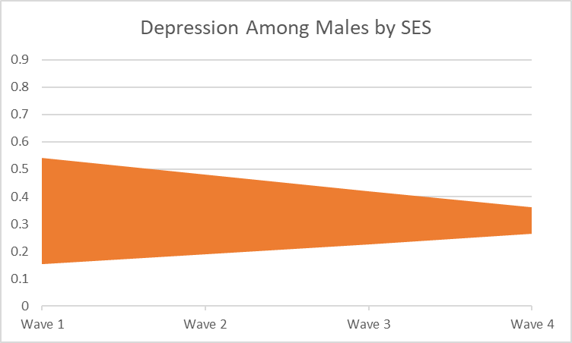
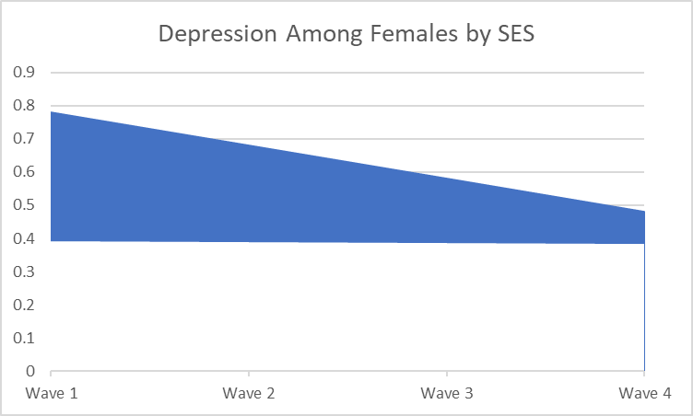
Real World Example
Using Longitudinal Analysis over 30 years, significant differences were found in average days depressed a week depending on participant gender and the annual income of the participants parents. The data shows that females and participants who come from families with low income experience more depressive days per week than their counterparts
The data on the right represents a study of 6504 participants across the United States by ADDHealth. After attrition and data cleaning 2392 participants remained
It is important to note that while this is a statistically significant difference, the average person experiences low to no depressive symptoms.

Slide 6
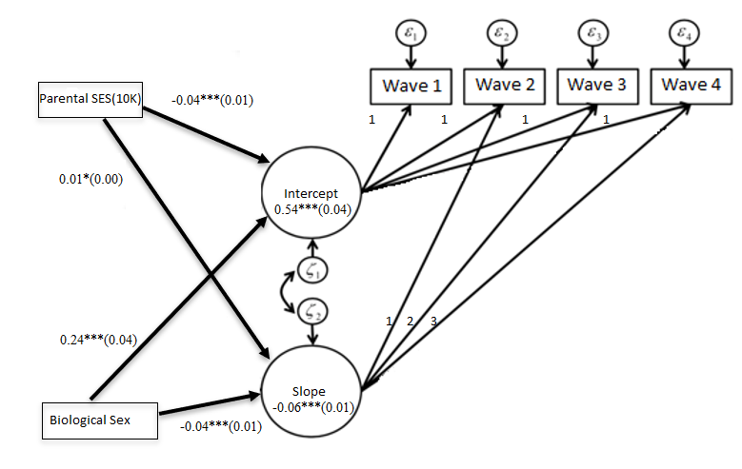
Real World Example
Y = (0.54 -0.04(SES) + 0.24(Gender)) + (-0.06 + 0.01(SES) – 0.04(Gender))(Wave)
For the Scientific Audience
The image on the right is the logic model of the data from the previous slide.
The numerical values represent the beta coefficients, stars for p-value, and the standard error of each coefficient.
To estimate values the values from the dataset on the left are multiplied by the numbers on their respective arrows and added to the slope and intercept values.

Slide 7
Methodology
Is time a factor and is the function linear?
Our first step in a longitudinal analysis is to determine if a time based model fits better than simply plotting the average.
If there’s reason to think the data might have a more complex pattern than a straight line, you can add extra dimensions to account for change between time points (quadratic or cubic)
We then compare these models based on measures of model fit. Most typically AIC and BIC would be used, but if these are plotted using SEM software comparative p-values are an option.

Slide 8
Methodology
Is there a difference between groups?
Based on the model with best fit, we can now create models that incorporate our variables of interest to see if we can make a better model and find differences between groups of interest.
While not necessary in this case, the way we test variables that change over time (time variant covariates) is different from ones which remain the same (time invariant covariates).
After creating models, another round of comparisons is done to see which fits best.
Model | AIC | BIC
Linear Model | 17935.78 | 17978.77
SES only | 17904.26 | 17961.59
Birth Gender only | 17863.74 | 17921.07
Combined Model | 17832.55 | 17904.21

Slide 9
Future Reading
If you have an interest in learning more about longitudinal analysis consider the following resources:
Grimm, K.J., Ram, N., & Estabrook, R. (2016). Growth modeling: Structural equation and multilevel modeling approaches
Singer, J.D., & Willett, J.B. (2003). Applied longitudinal data analysis: Modeling change and event occurrence

Slide 10
Questions
Please direct questions to William.Lage3@Gmail.com

